Slide 1

Bank Marketing(Campaign)
Prediction for Term Deposit subscription
12th May 2023

Slide 2
Group Name: One
Name: Hira Fahim
Email: hirashahidd26@yahoo.com
Country: United Kingdom
Company: Unemployed
Specialization: Data Science
Batch Code: LISUM19
Submission Date: 12th May 2023
Submitted to: Data Glacier

Slide 3
Background – Bank Marketing Campaign
Problem Description:
ABC Bank wants to sell its term deposit product to customers and before launching the product they want to develop a model which help them in understanding whether a particular customer will buy their product or not (based on customer's past interaction with bank or other Financial Institution).
Hira Fahim

Slide 4
Approach
The analysis has been divided into following parts:
Data Understanding
Exploratory Data Analysis
Univariate Analysis
Correlation Analysis
Bivariate Analysis
Feature Engineering
Model Building
Model Evaluation
Model Selection
Model Deployment
Hira Fahim

Slide 5
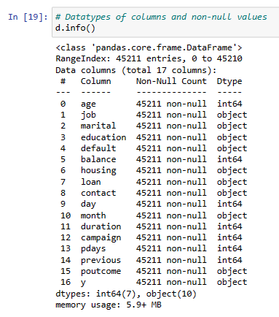
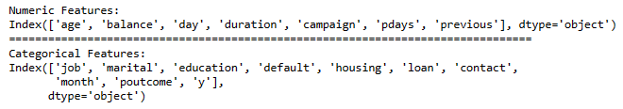
Data Understanding
Dataset Information
The data is related with direct marketing campaigns of a Portuguese banking institution. The marketing campaigns were based on phone calls. Often, more than one contact to the same client was required, to access if the product (bank term deposit) would be ('yes') or not ('no') subscribed.
Datatype of Columns and Non-null values
Numerical and categorical Features
Hira Fahim

Slide 6
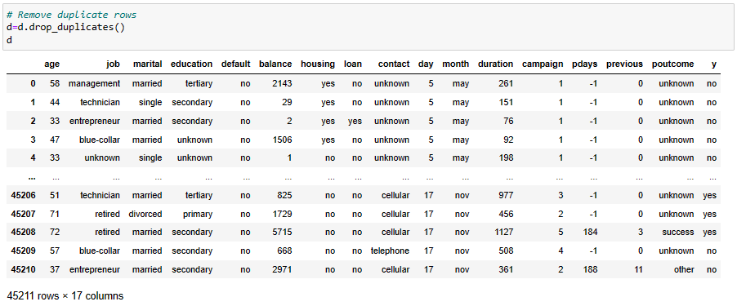
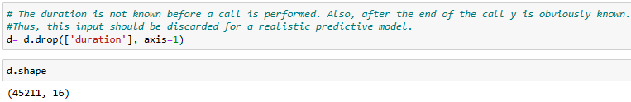
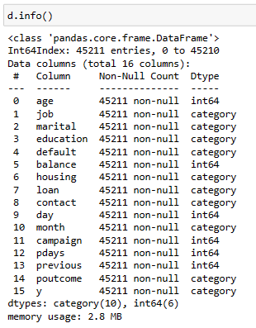
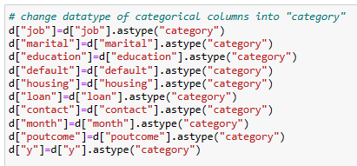
Exploratory Data Analysis
Step:1 Drop Duplicate Rows
Step:2 Drop Unnecessary Column
Final Dataset
Step:3 Change Datatype of Categorical features
Hira Fahim

Slide 7
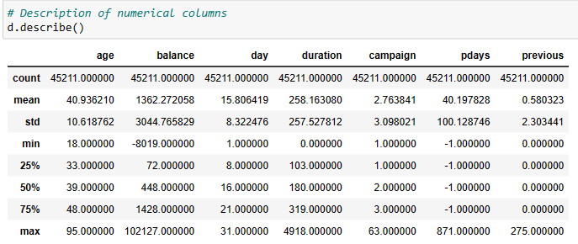
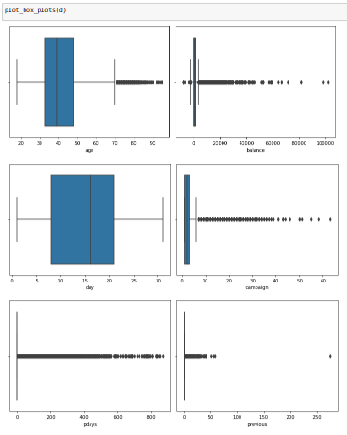
Univariate Analysis
Description of the data
Visualization (boxplot) of Numerical Attributes
From description and boxplot, we can see there are outliers in numerical input variables like age, balance, campaign, pdays and previous. Pdays have most outliers comparatively.
Hira Fahim

Slide 8
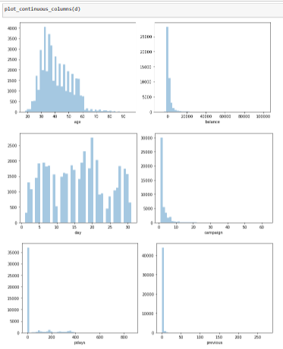
Univariate Analysis
Histogram for Numerical Attributes
In Histogram, we can see input variables like age, balance, campaign, pdays and previous are positively skewed, and we can also see uneven distribution of data in day column.
Hira Fahim

Slide 9
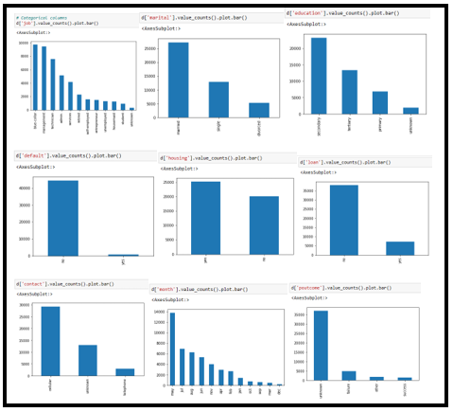
Univariate Analysis
Visualization of Categorical Attributes
In Bar chart of categorical columns, we see uneven distribution of data in all the input categorical columns.
Hira Fahim

Slide 10
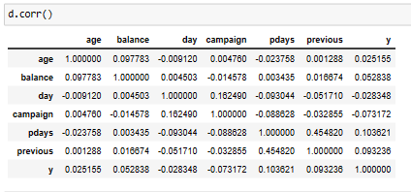
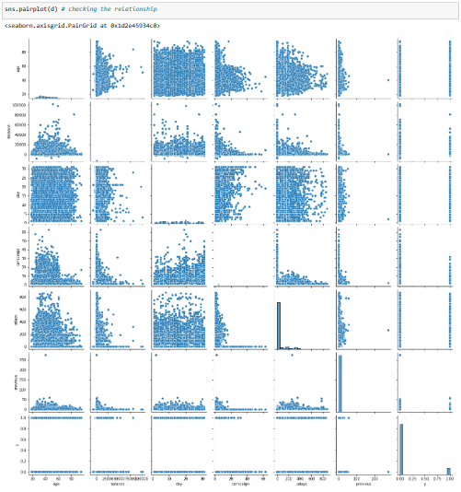
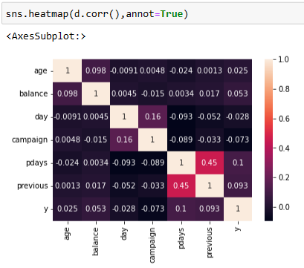
Correlation Analysis
Correlation between numerical input and Output variables
Pairplot
From Correlation Analysis, we see there is less correlation between numerical attribute and output variable
Heat Map
Hira Fahim

Slide 11
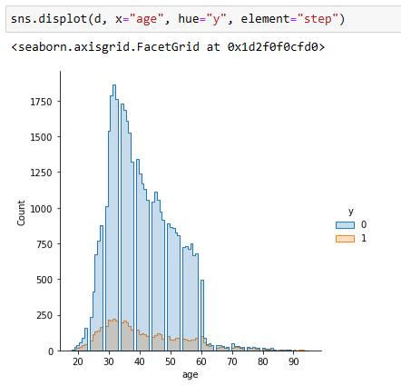
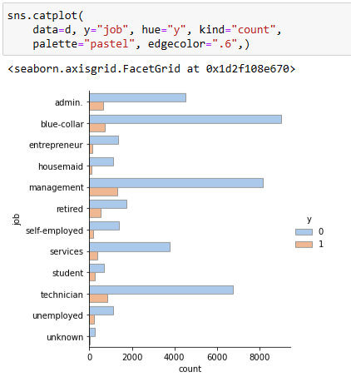
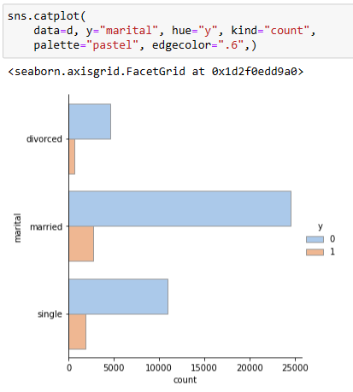
Bivariate Analysis
Term Deposit based on Age
Term Deposit based on Job
Term Deposit based on Marital status
Clients between age 30-40 are more responsive towards term deposit
Clients with job related to 'management, blue-collar and technician' have subscribed for deposit.
Married Clients are main contributor of deposit scheme.
Hira Fahim

Slide 12
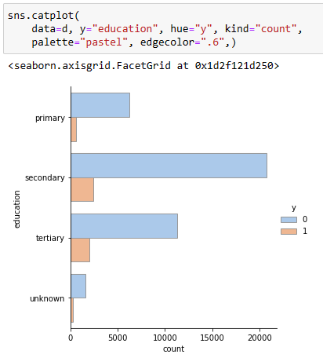
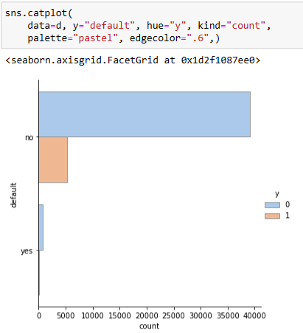
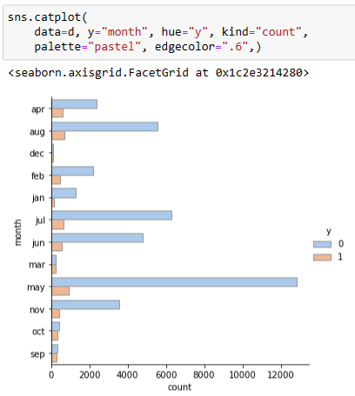
Bivariate Analysis
Term Deposit based on Education
Term Deposit based on Credit default
Term Deposit based on Month
Clients with secondary and tertiary educational background are main contributors.
Clients with good credit history are more interested in term deposit
Investment in term deposit is fluctuating throughout the year but in the month of ‘May’ we have highest success rate.
Hira Fahim

Slide 13
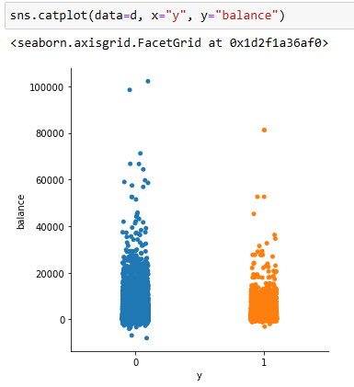
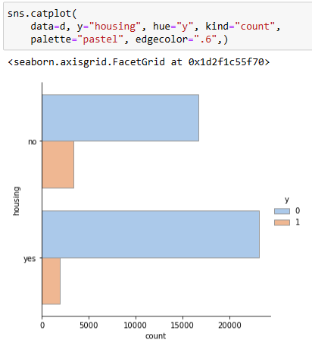
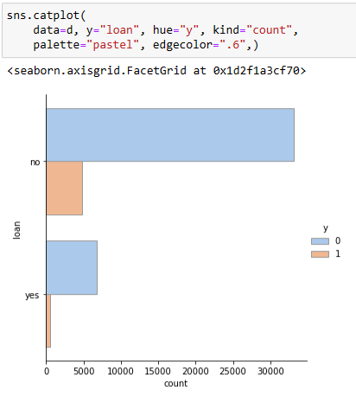
Bivariate Analysis
Term Deposit based on Balance
Term Deposit based on Housing Loan
Term Deposit based on Personal Loan
Client with balance up to 20,000 are more interested in term deposit
Client with no housing loan have subscribed for the term deposit
Client with no personal loan are more interested in term deposit.
Hira Fahim

Slide 14
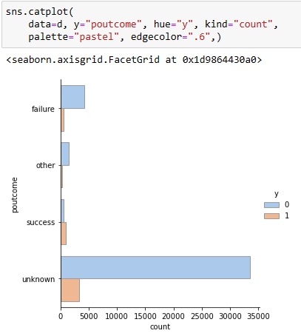
Bivariate Analysis
Term Deposit based on Outcome of Previous Campaign
From the Outcome of previous Campaign, if the outcome is Failure, then there is a less chance that client will subscribe to the term deposit. whereas if the outcome of previous Campaign is Success, then it is more likely that Client will subscribe to the term deposit.
Hira Fahim

Slide 15
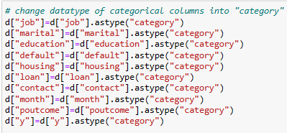
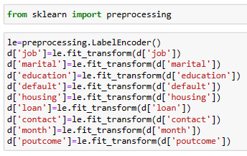
Feature Engineering
Step 1: Change datatype of Categorical Features
Step 2: Encode Categorical Columns into Numerical using Label encoding
Hira Fahim

Slide 16
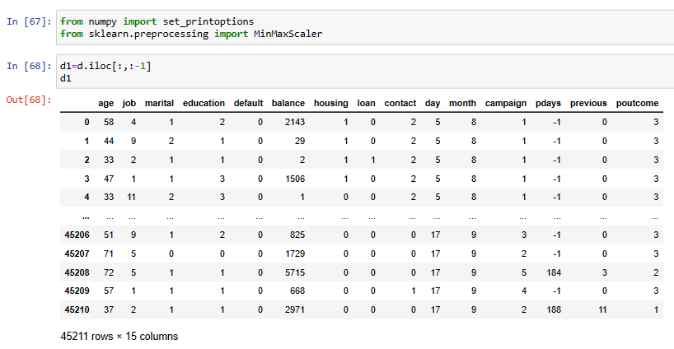
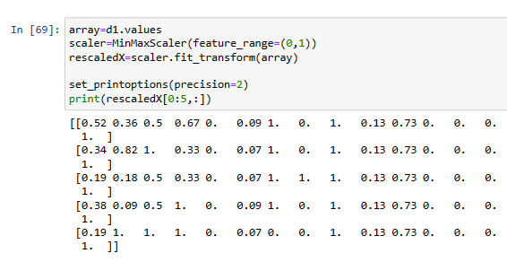
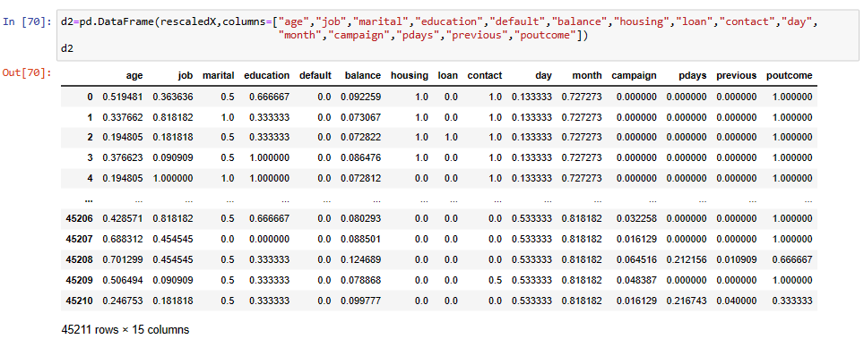
Feature Engineering
Last step: Feature Scaling using Normalization technique
Final Dataset for Model building
Hira Fahim

Slide 17
Model Building
The dataset is imbalance, so we will balance the dataset using SMOTE.
Divide the dataset into input variables and output variable then split the input and output into train and test sets (30% test and 70% train).
Different Machine Learning models to predict the term deposit subscription :
Logistic Regression
Random Forest
Gradient Boosting
Hira Fahim

Slide 18
Model Evaluation
Metrics of Evaluation
Accuracy, Precision, Recall and F1-Score
Scores of Test, Train and Complete dataset
Confusion Matrix
Lift and Gain
KS Statistics and ROC-AUC Score
Hira Fahim

Slide 19
Model Selection
Model selection based on Scores and Confusion Matrix
Model | Score All Dataset | Score Train Dataset | Score Test Dataset | TN | FP | FN | TP
Logistic Regression | 0.63 | 0.66 | 0.66 | 7288 | 3572 | 4501 | 8593
Random Forest | 0.76 | 0.72 | 0.71 | 9245 | 2544 | 4207 | 7958
Gradient Boosting | 0.898 | 0.94 | 0.93 | 11442 | 347 | 1242 | 10923
Gradient Boosting + Hyperparameter Tuning | 0.895 | 0.93 | 0.92 | 11385 | 404 | 1276 | 10886
Based on scores and confusion matrix Gradient Boosting without hyperparameter tuning is the best model.
Hira Fahim

Slide 20
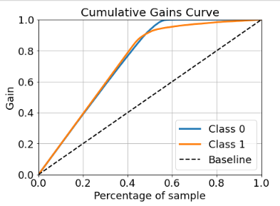
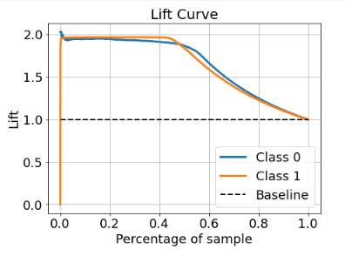
Model Selection
Model selection based on Lift and Gain Curve
Cumulative gains and lift charts are visual aids for measuring model performance.
The Greater the area between the Lift / Gain and Baseline, the Better the model.
By analysing Gain and Lift Curve, Gradient Boosting Classifier is the best model.
Gradient Boosting Classification Model
Hira Fahim

Slide 21
Model Selection
Model selection based on Accuracy, Precision, Recall, F1 Score, KS statistics and AUC-ROC
Model | Precision | Recall | F1 score | Accuracy | KS Statics | AUC- ROC
Logistic Regression | 0 – 0.67 1 – 0.66 | 0.62 0.71 | 0.64 0.68 | 0.66 | 0.336 | 0.7246
Random Forest | 0 –0.69 1 – 0.76 | 0.78 0.65 | 0.73 0.70 | 0.72 | 0.4475 | 0.785
Gradient Boosting | 0 – 0.90 1 – 0.97 | 0.97 0.90 | 0.94 0.93 | 0.93 | 0.8697 | 0.97
Gradient Boosting + Hyperparameter Tuning | 0 – 0.90 1 – 0.96 | 0.97 0.89 | 0.93 0.93 | 0.93 | 0.861 | 0.961
The F1- Score, KS statistics and AUC-ROC metrics of KNNC model are the best. Therefore, The best model for deployment is Gradient Boosting Classification model.
Hira Fahim

Slide 22
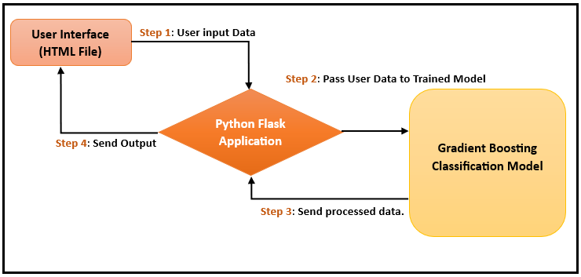
Model Deployment
Given Workflow shows Gradient Boosting classification model is used and Flask Framework for deployment. It represents the details of how the model works from user interface till the results.
Hira Fahim

Slide 23
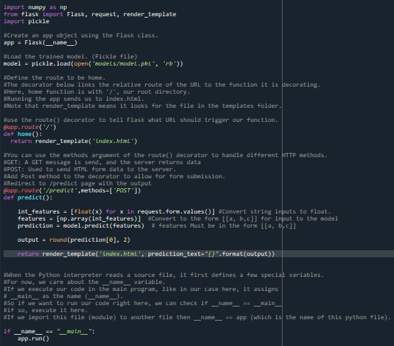
Model Deployment
Save the model using Pickle.
Deploy the model using Flask framework.
The app.py file contains the source code including the ML code for prediction and will be execute by the Python interpreter to run the Flask web application.
The Index.html file will render a text form where a user enter the details of required fields. Index.html file will be rendered via the render_template ('index.html', prediction_text="{}".format(output)), which is inside the predict function of app.py script to display the output as per the input submitted by the user.
The URL generate by ‘app.py.’ Open a web browser and navigate to http://127.0.0.1:5000/ following is output of Index.html.
Hira Fahim

Slide 24
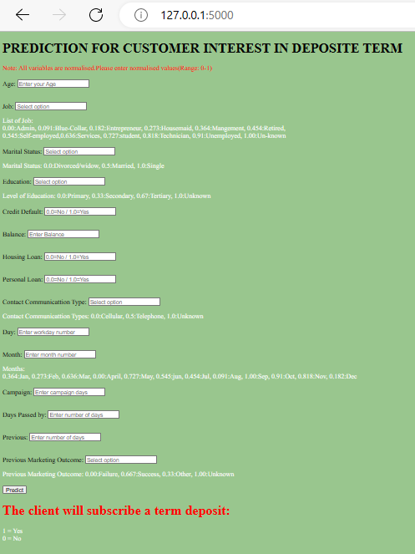
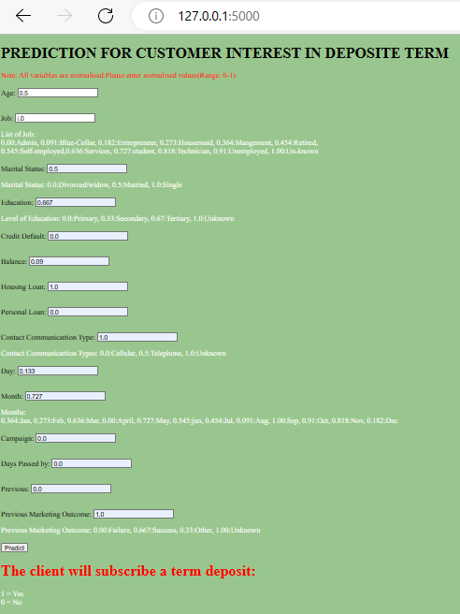
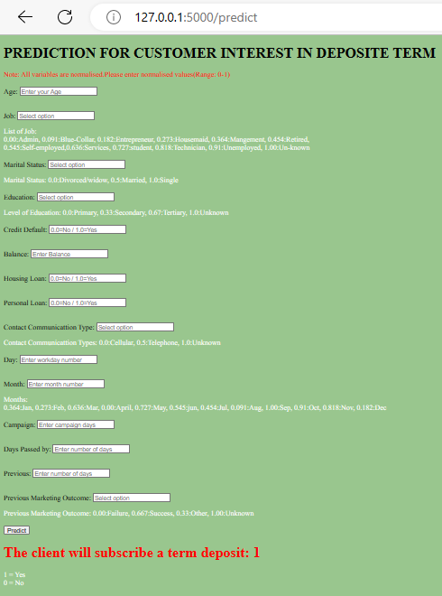
Model Deployment
Select categorical fields as per their respective number in the given code and click the Predict button. The predicted result will be displayed at the bottom of the web page.
Hira Fahim

Slide 25
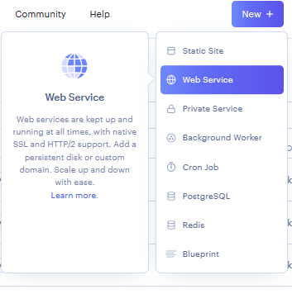
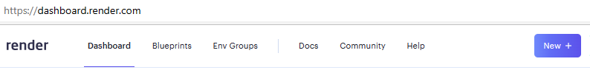
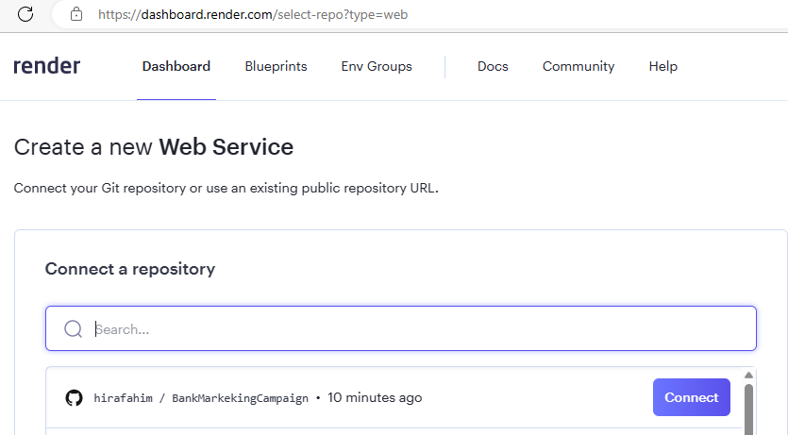
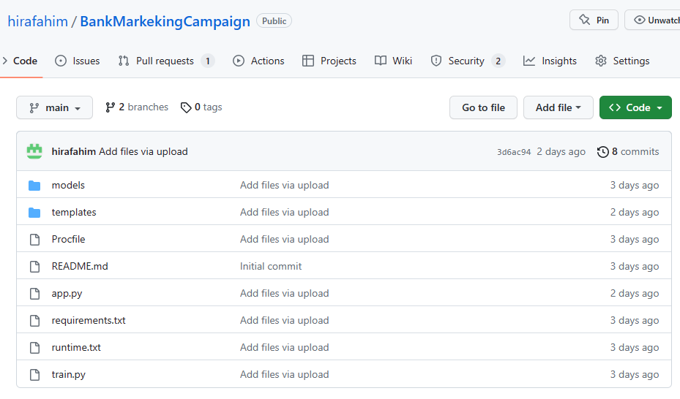
Model Deployment on Render (Open-Source Cloud Deployment)
After the model has been trained and deployed locally, now it is ready for deploy on open-source cloud “Render”.
Connect web service to GitHub Repository.
Click and open the application for Term deposit subscription.
https://predict-bank-term-depositsubscription.onrender.com
Hira Fahim

Slide 26
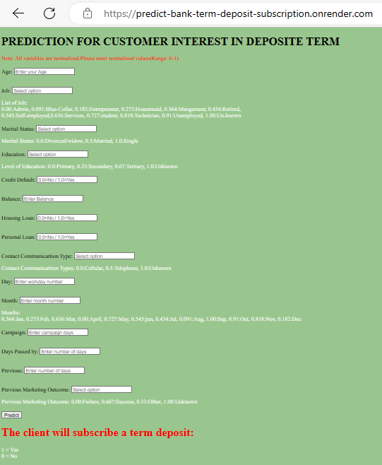
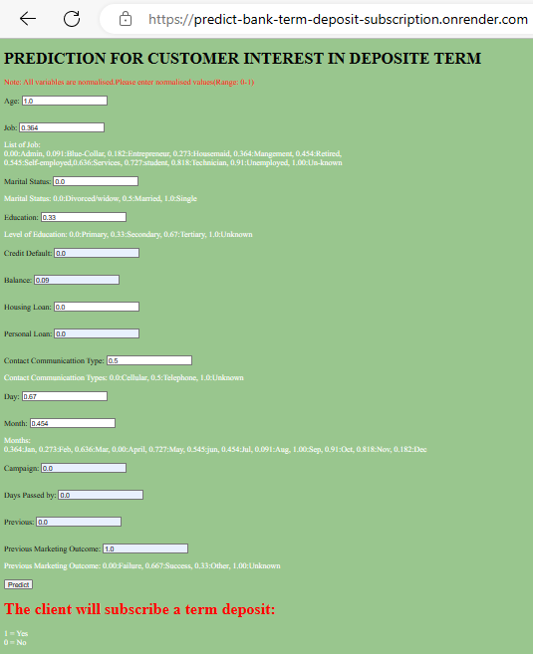
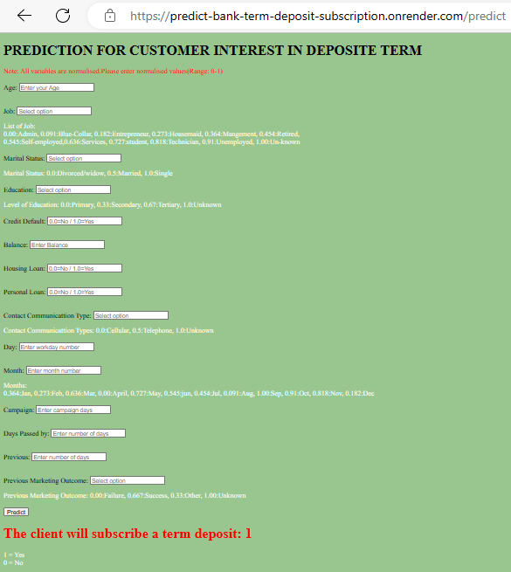
Model Deployment on Render (Open-Source Cloud Deployment)
Select categorical fields as per their respective number in the given code and click the Predict button. The predicted result will be displayed at the bottom of the web page.
Hira Fahim

Slide 27
Challenges
Feature scaling was a challenging task, which is done normalization technique as the dataset consists of both numerical and categorical features.
Selection of best model was also tricky but after carefully considering all parameters and metrics of evaluation choose ‘Gradient Boosting Classification model’ as the best model.
Hira Fahim

Slide 28
Thank You
Hira Fahim

